Slide 1
MRI Faces ROI analysis results (SVM) vmPFC, SPL, Striatum, Hippocampus 16 predictors: 4 x 2 x 2 4 ROI, 2 hemispheres – for each mean and std predicted binary variable: % chosen Go is above/below median

Slide 2
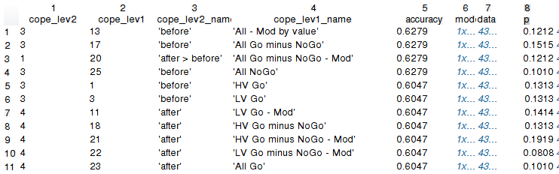
Response to stim – session 1
Nothing significant

Slide 3
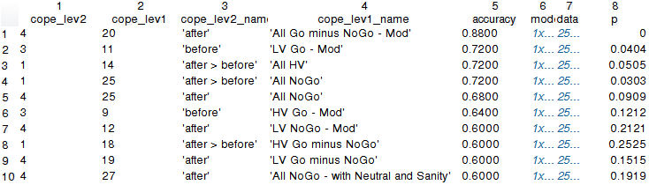
Response to stim – session 2
Hard to interpret – NoGo and modulated results

Slide 4
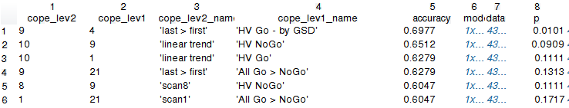
Training – session 1
Balagan – only HV Go by GSD

Slide 5
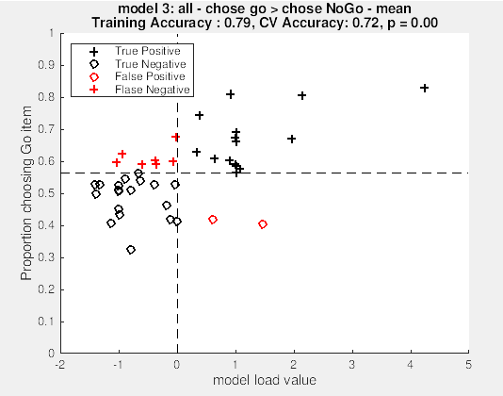
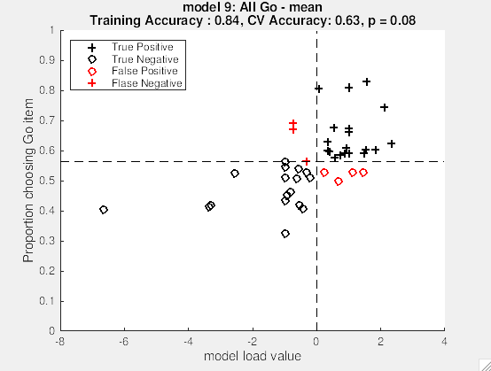
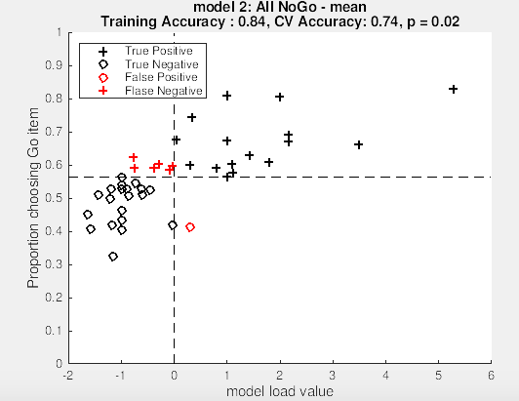
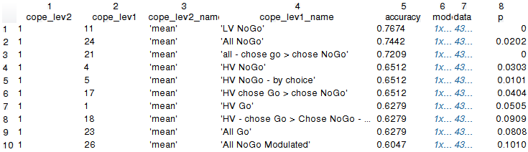
Probe – session 1
All Choose Go > NoGo (where we also got vmPFC in the GLM)
All Go and All NoGo

Slide 6
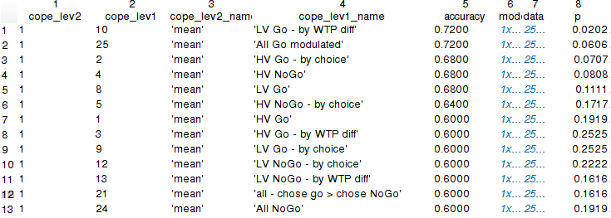
Probe – session 2
Hard to interpret – NoGo and modulated results

Slide 7
MRI Faces Face ROI analysis results (SVM) FFA, OFA and STS 18 predictors: 3 x 2 x 3 3 ROI, 2 hemispheres – for each mean, std and ROI size predicted binary variable: % chosen Go is above/below median

Slide 8
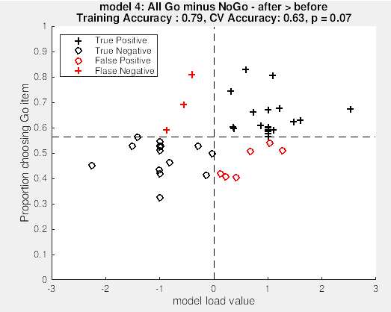
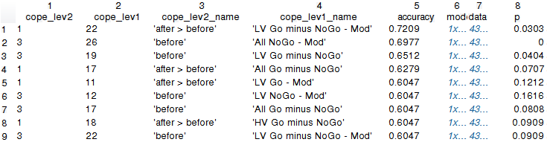
Response to stim – session 1
All Go minus NoGo (After > Before) – close to significance

Slide 9
Response to stim – session 2
Nothing significant

Slide 10
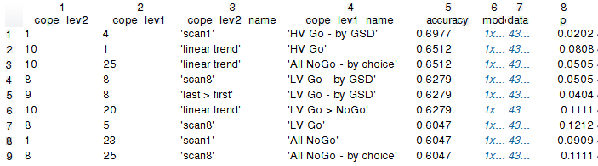
Training – session 1
Balagan

Slide 11
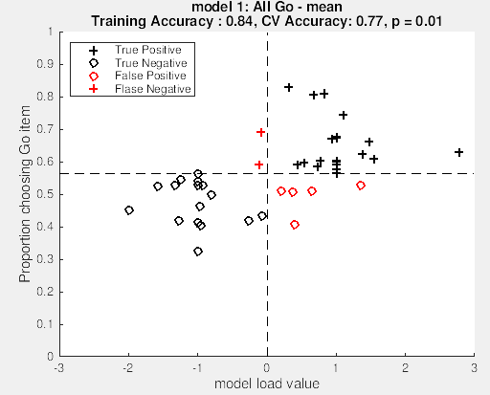
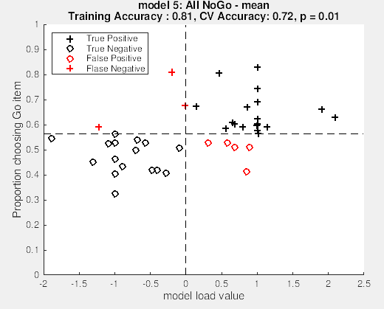
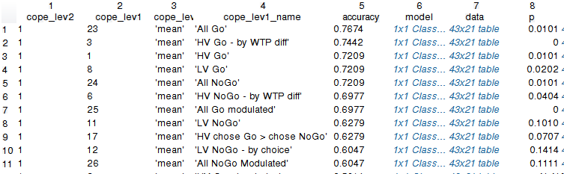
Probe – session 1
All Go
Also All NoGo

Slide 12
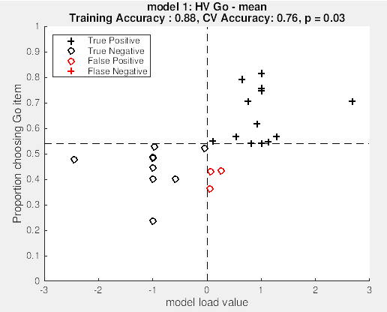
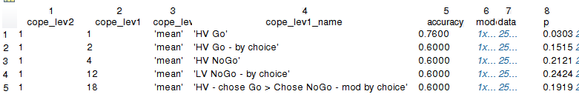
Probe – session 2
Only HV – marginal

